Slide 1



LANGUAGE
GRADE 2
YEAR 1

Slide 2
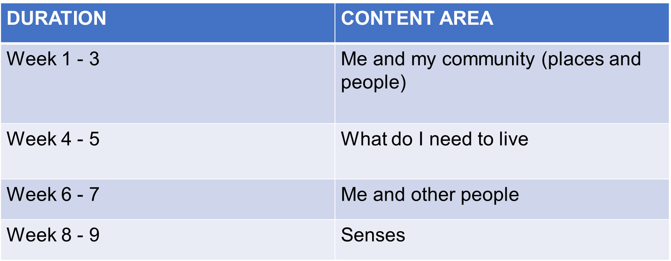
OUTLINE

Slide 3
ASSEESSMENT GOALS
LISTENING AND SPEAKING
Listen to short stories, simple songs and action rhymes
Use visual and pictorial cues to make meaning
Follow more complex instructions
Compare and classify information
Use language for communication

Slide 4
PHONOLOGICAL AWARENESS AND PHONICS
Develop auditory sequence and memory
Develop auditory perception
Develop auditory closure
Develop auditory elimination
Recognise and use sight words
Identify the sounds that have been taught

Slide 5
EMERGENT READING
Sequence pictures
Develop basic concepts of print
“Read” aloud
SHARED READING
“Read” picture books, rhymes, big books, posters with the teacher
Respond creatively to stories
Draw pictures capturing main idea of the stories
INDEPENDENT READING
“Read” independently

Slide 6

WEEK 1 & 2

Slide 7
ASSEESSMENT GOALS
LISTENING AND SPEAKING
Listen to short stories, simple songs and action rhymes
Use visual and pictorial cues to make meaning
Follow more complex instructions
Compare and classify information
Use language for communication

Slide 8

ME AND MY COMMUNITY

Slide 9
LESSON OBJECTIVES
The learner must be able to:
Acknowledge that he/she is part of a community
Know the roles, rules and responsibilities in the community
Discuss ways how the community can work together to make it a nice place to live in
Know how to assist people in the community
Write their name

Slide 10
GROUP 1

Slide 11
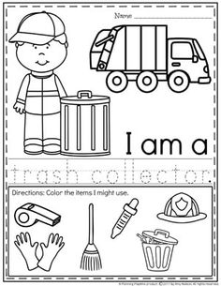
Task 1: Colour the picture

Slide 12
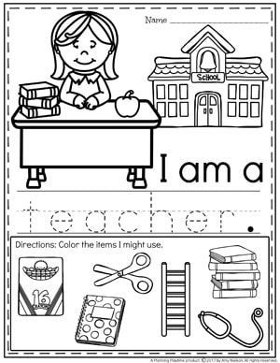
Colour in the picture

Slide 13
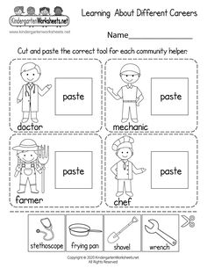
Task 2: Cut and paste the correct tool for each community helper

Slide 14
GROUP 2

Slide 15
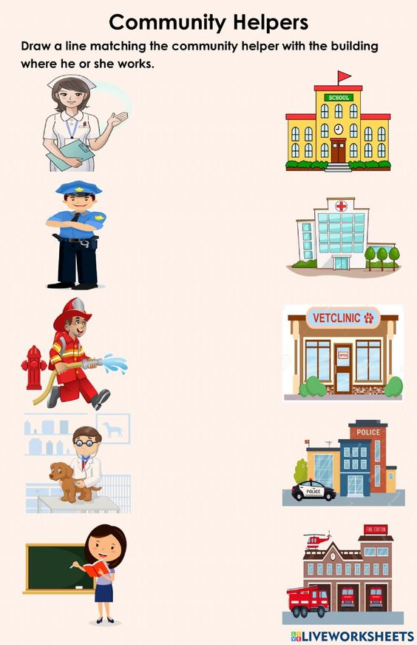
Task 1: Write down the names of each community helper

Slide 16
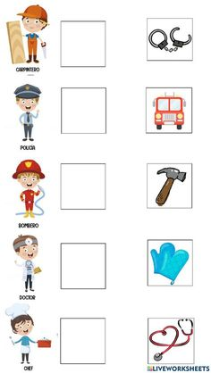
Task 2: Cut out the correct picture that matches the correct community helper

Slide 17
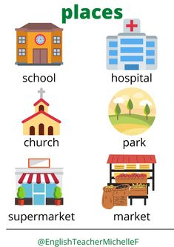
Task 3: Match the following pictures with the correct place and write 1 sentence.

Slide 18
GROUP 3

Slide 19
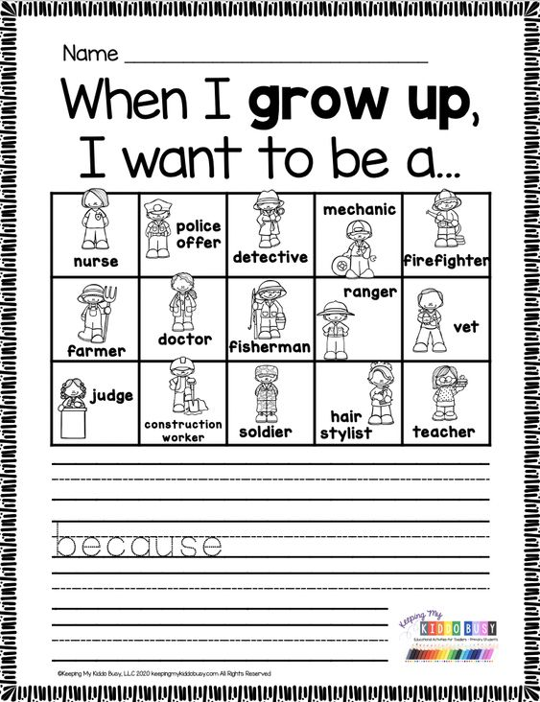
Task 1: Choose one community helper and say why you chose that one.

Slide 20
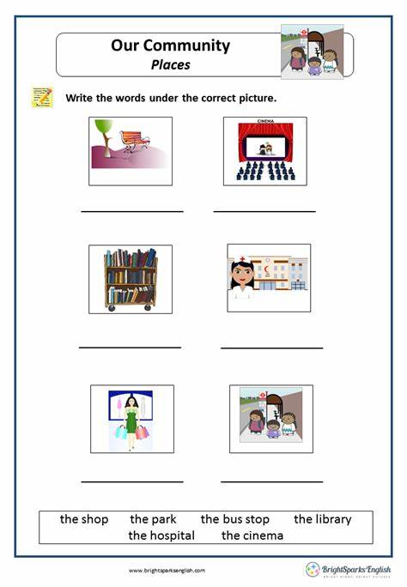
Task 2: Write the words under the correct picture.

Slide 21
WEEK 3 & 4 what do l need to live

Slide 22

WHAT DO I NEED TO LIVE

Slide 23
LESSON OBJECTIVES
Know the importance of keeping the body healthy in order to live.
Eating healthy and the importance of exercising to keep the body healthy and fit.
Water, why we need water, sources of water.
Air, Clean air. Sunlight- include protection from the sun.
Vocabulary words

Slide 24
GROUP 1

Slide 25
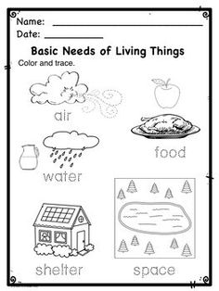
Task 1: Colour and trace things that we need to live

Slide 26
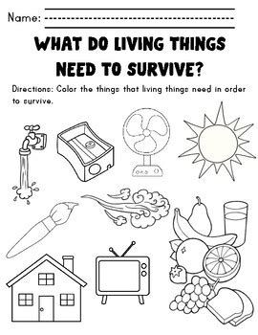
Task 2: Colour all the things that we need to live.

Slide 27
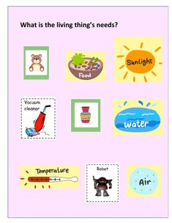
Task 3: Study the picture below, and say what we need to live.

Slide 28
GROUP 2

Slide 29
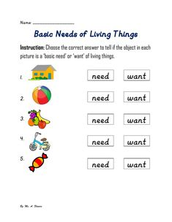
Task 1: Choose the correct answer to tell the objects we need to live and the ones we don’t need.

Slide 30
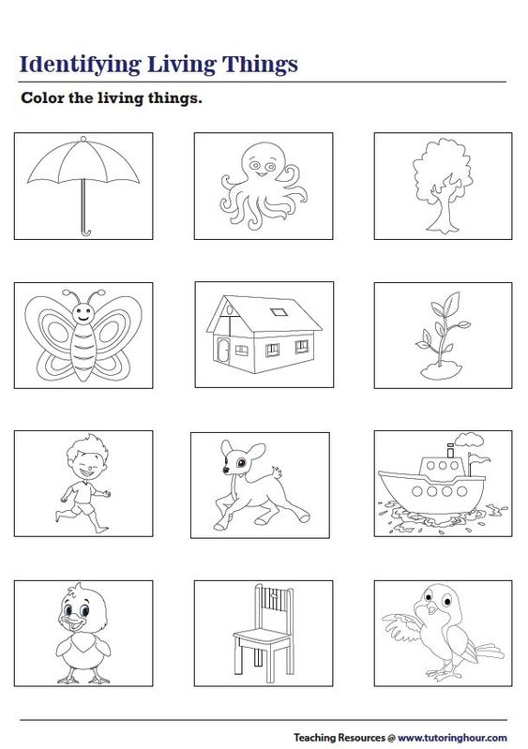
Task 2: Colour the pictures that we need to live.

Slide 31
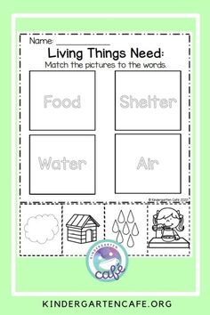
Task 3: Match the pictures to the words

Slide 32
GROUP 3

Slide 33
Task 1: fill in the blank spaces according to what we need to live
Food Water Air Sunlight Shelter
We need ___________to survive
We need fresh _______________to live
We need to eat _____________in order to live
We need ______________to keep warm
We need ______________ to live

Slide 34
Task 2: circlet correct answer with true or false
Drinking water is important to keep us hydrated. True/false
We do not need shelter to live. True/false
We do not need food to live. True/false
The air tat we breath is important. True/false

Slide 35
Task 3:Colour only the pictures that we need to live

Slide 36
WEEK 6 & 7
ME AND OTHER PEOPLE

Slide 37
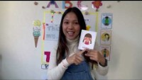
Me and other people

Slide 38
LESSON OBJECTIVES
Identify different people around them, boys and girls
The learner should be able to differentiate between elders and his/her peers.
Know the importance of friendship and how to make friends.

Slide 39
GROUP 1

Slide 40
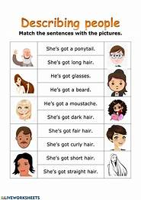
Task 1: Me and other people: Match the sentence with the picture

Slide 41
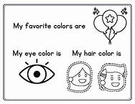
Task 2: Me and other people: colour in the worksheet

Slide 42
GROUP 2

Slide 43
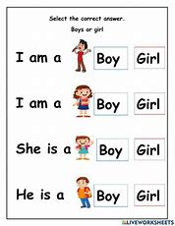
Task 1: Me and other people: Choose the correct word

Slide 44
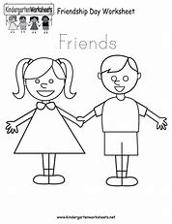
Task 1: Me and other people: colour in the worksheet

Slide 45
GROUP 3

Slide 46
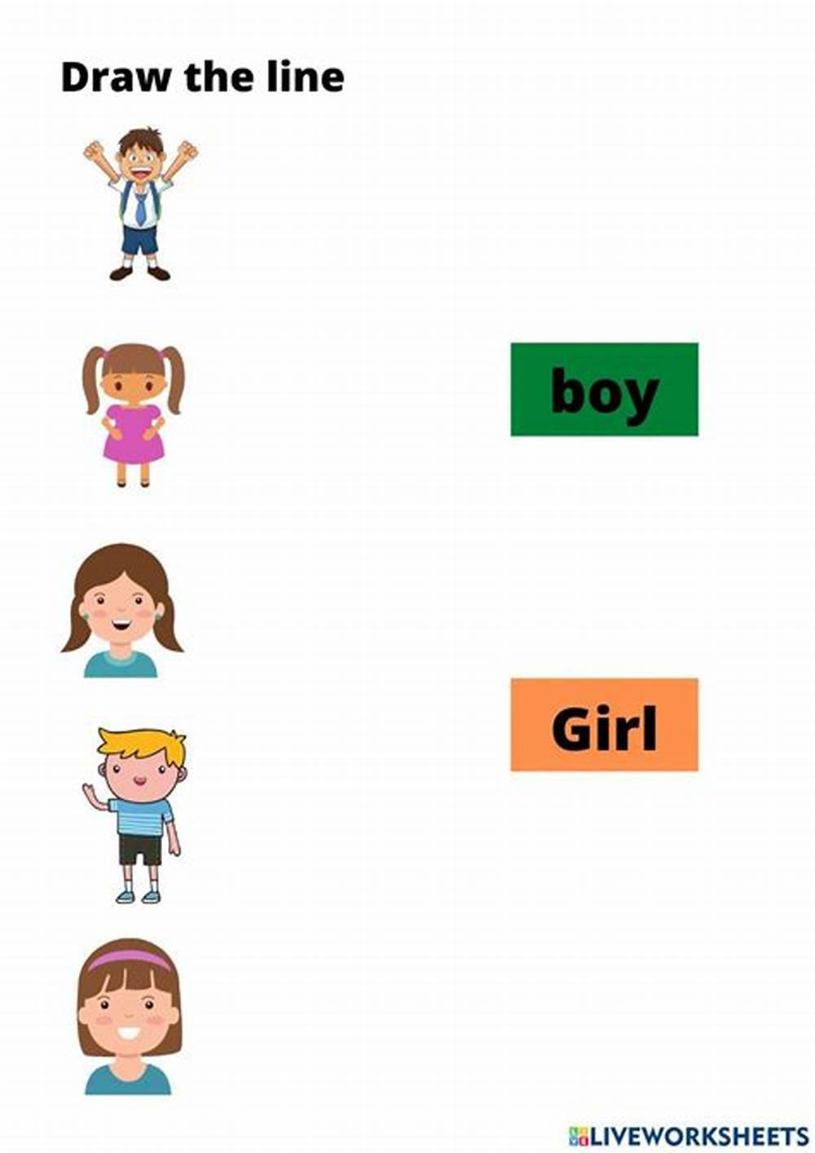
Task 1: Me and other people
Draw a line to the correct word

Slide 47
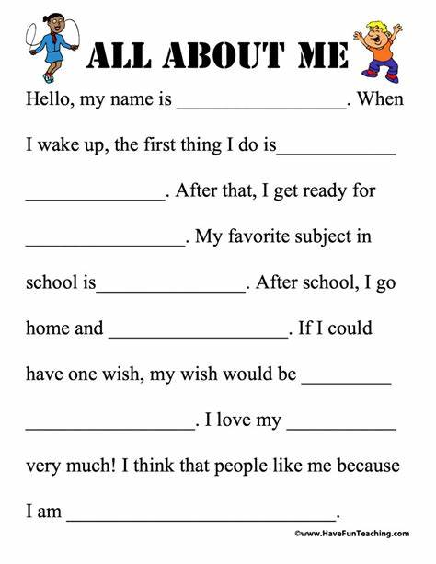
Task 1: Me and other people fill in the correct answers

Slide 48
WEEK 5, 6 & 7
SENSES

Slide 49
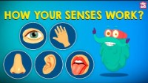
SENSES

Slide 50
LESSON OBJECTIVES
Name different fruits that they know.
Name different vegetables that they know.
Explain the importance of fruits and vegetables in our bodies.

Slide 51
GROUP 1

Slide 52
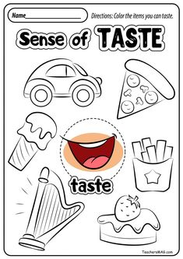
Task 1: Colour the taste sense below.

Slide 53
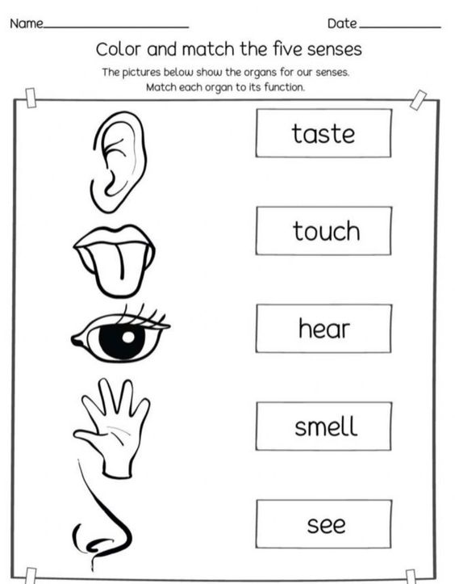
Task 2: Colour and match the five senses

Slide 54
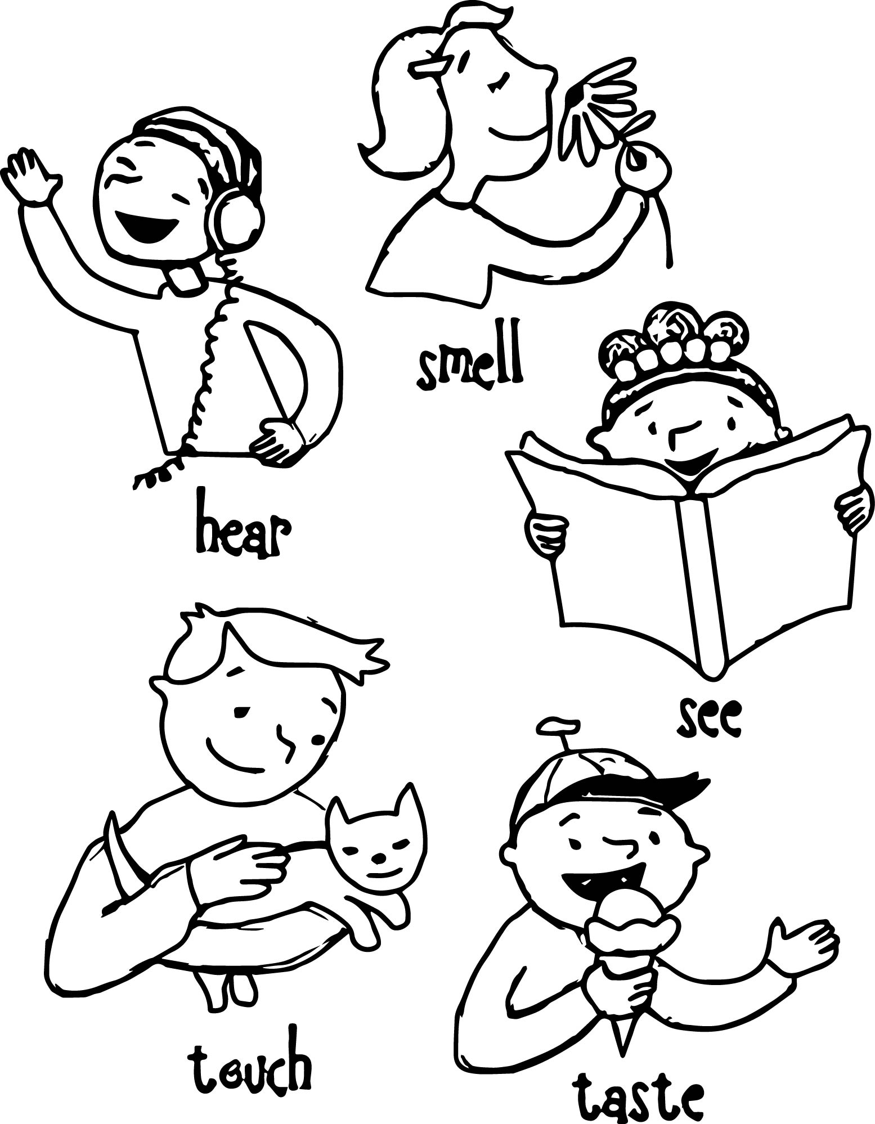

Task 2: Colour in the picture below

Slide 55
GROUP 2

Slide 56
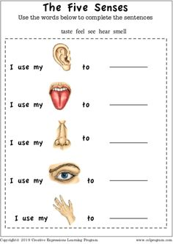
Task 1:Use the words below to complete the sentences
taste feel see hear smell .

Slide 57
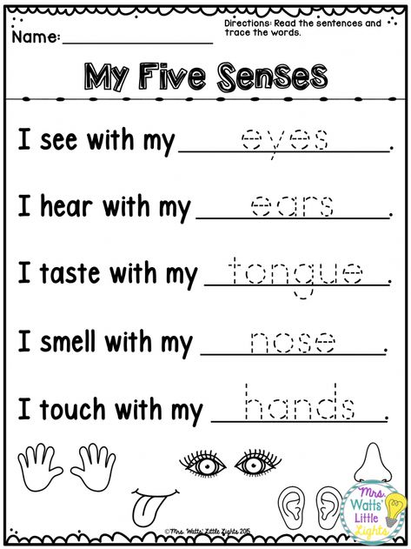
Task 2: Trace the following words

Slide 58
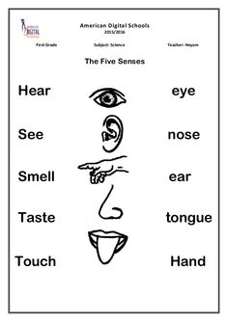
Task 2: Match the picture with the correct word.

Slide 59
GROUP 3

Slide 60
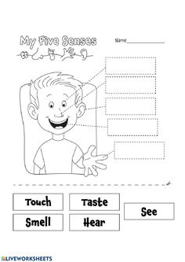
Task 1:Cut and paste the words and paste them accordingly.

Slide 61
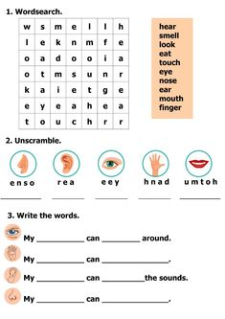
Task 2: .Complete the task below

Slide 62
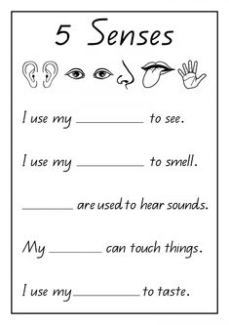
Task 3: fill in the correct words using the pictures above.

Slide 63
Resources
www.k5learning.com
www. sparklebox.co.uk
www.twinkl.co.za
www.Pinterest.com

